Slide 1
Unit - 4

Slide 2
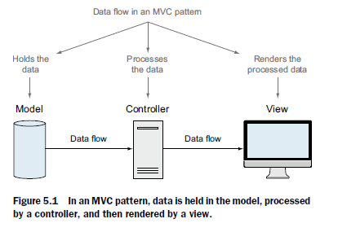
Data flow in MVC

Slide 3
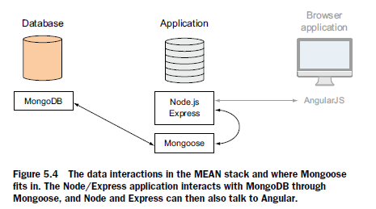
MEAN stack(where Mongoose fits)

Slide 4
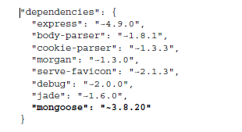
Adding Mongoose to our application
$ npm install --save mongoose

Slide 5
Adding a Mongoose connection to our application
MONGODB AND MONGOOSE CONNECTION
Mongoose opens :
pool 5 reusable connections when it connects to a MongoDB db.
pool incresed/decreased

Slide 6
SETTING UP THE CONNECTION FILE
2 steps:
Creating the file
Requiring it into the application
db.js
var mongoose = require( 'mongoose' );
app.js
var express = require('express');
var path = require('path');
var favicon = require('serve-favicon');
var logger = require('morgan');
var cookieParser = require('cookie-parser');
var bodyParser = require('body-parser');
require('./app_server/models/db');

Slide 7
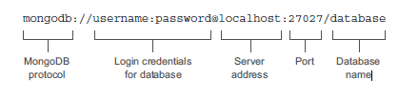
CREATING THE MONGOOSE CONNECTION
var dbURI = 'mongodb://localhost/Loc8r';
mongoose.connect(dbURI);

Slide 8
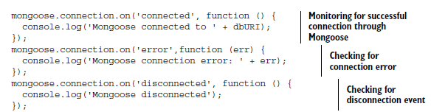
MONITORING THE CONNECTION WITH MONGOOSE CONNECTION EVENTS (db.js)
Express server listening on port 3000
Mongoose connected to mongodb://localhoExpress server listening on port 3000
Mongoose connected to mongodb://localhost/Loc8rst/Loc8r

Slide 9
CLOSING A MONGOOSE CONNECTION
To monitor when the application stops
listen to the Node.js process event : SIGINT.
Listening for SIGINT on Windows
SIGINT is an OSf–level signal
Unix-based systems like Linux and Mac OS X,
Windows(npm package -> readline)
"dependencies": {
"express": "3.4.x", "jade": "*",
"mongoose": "3.8.x",
"readline": "0.0.x"
}

Slide 10
SIGINT
In db.js file, add :
var readLine = require ("readline");
if (process.platform === "win32"){
var rl = readLine.createInterface ({
input: process.stdin,
output: process.stdout
});
rl.on ("SIGINT", function (){
process.emit ("SIGINT");
});
}
gracefully close down

Slide 11
COMPLETE CONNECTION FILE(db.js)
■ Defined a database connection string
■ Opened a Mongoose connection at application startup
■ Monitored the Mongoose connection events
■ Monitored some Node process events
close the Mongoose connection when the application ends

Slide 12
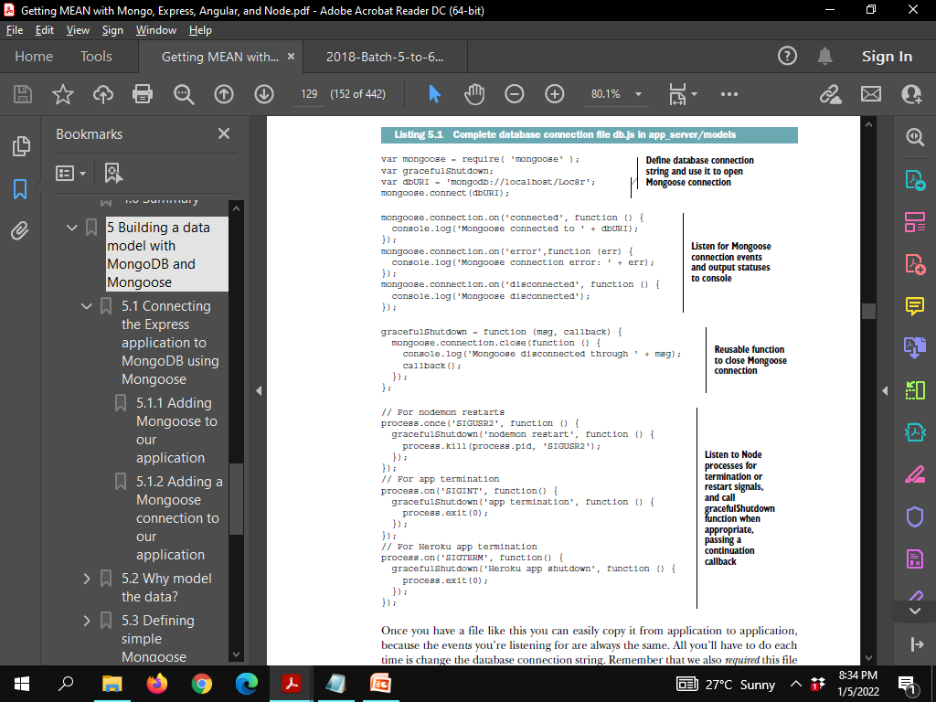

Slide 14
Using/Connecting to multiple dbs
Instead of mongoose.connect method
Use mongoose.createConnection
var dbURIlog = 'mongodb://localhost/Loc8rLog';
var logDB = mongoose.createConnection(dbURIlog);
new Mongoose connection object called logDB.
interacts like mongoose.connection for the default connection.
Examples:
logDB.on('connected', function () {
console.log('Mongoose connected to ' + dbURIlog);
});
logDB.close(function () {
console.log('Mongoose log disconnected');
});

Slide 15
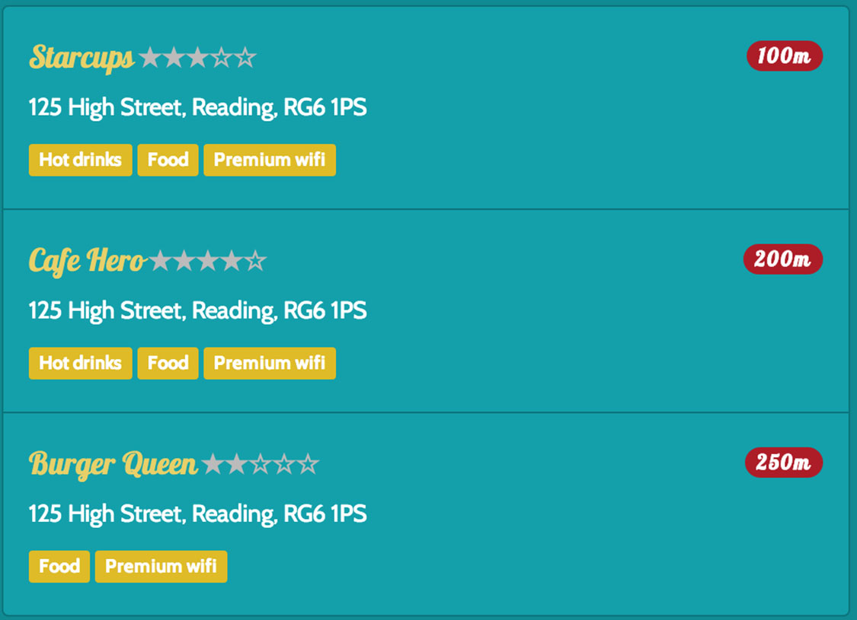
Why model the data? What is Mongoose and how does it work?

Slide 16
LOC8r
The page needs these data items for all locations the data record for each location must have a consistent naming structure.
Without this, the application wouldn’t be able to find the data and use it.
Data :
controller ->view.
MVC architecture:
view -> controller.
move it ->model.

Slide 17
Modeling data:
describing how we want the data to be structured.
What is Mongoose and how does it work?
In MongoDB each entry in a database is called a document.
In MongoDB a collection of documents is called a collection (think “table” if you’re used to relational databases).
In Mongoose the definition of a document is called a schema.
Each individual data entity defined in a schema is called a path.

Slide 18
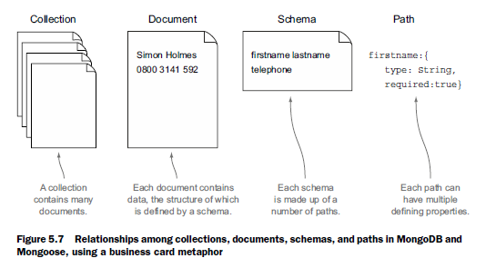
Example of a stack of business card
A model is the compiled version of a schema.
All data interactions using Mongoose go through the model.

Slide 19
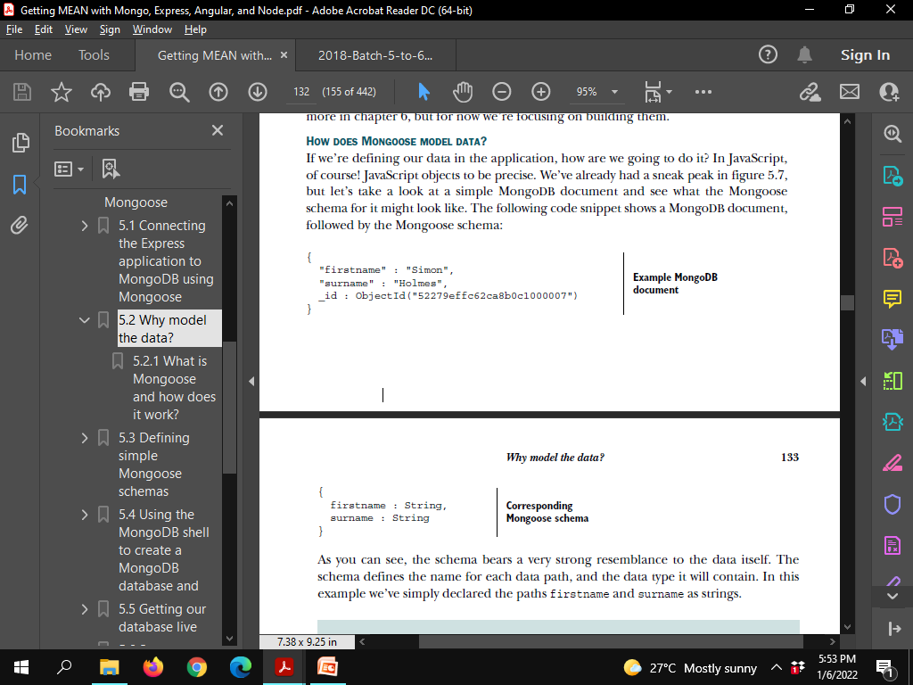
HOW DOES MONGOOSE MODEL DATA?
_id:ObjectId

Slide 20
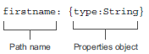
BREAKING DOWN A SCHEMA PATH
Allowed schema types

Slide 21
Allowed schema types
■ String: Any string, UTF-8 encoded
■ Number : Mongoose doesn’t support long or double numbers, (Mongoose plugins)
■ Date:(returned from MongoDB as an ISO Date object
■ Boolean:True or false
■ Buffer:For binary information such as images
■ Mixed:Any data type
■ Array: Array of the same data type/ nested subdocuments
■ ObjectId:For a unique ID in a path other than _id;
(used to reference _id paths in other documents

Slide 22
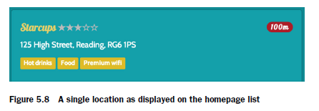
Defining simple Mongoose schemas (basics of setting up a schema)
var locationSchema = new mongoose.Schema({ });

Slide 23
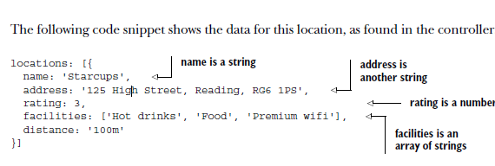
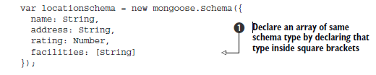
Controller data

Slide 24
ASSIGNING DEFAULT VALUES , ADDING SOME BASIC VALIDATION: REQUIRED FIELDS, NUMBER BOUNDARIES
rating: {type: Number, "default": 0}
name: {type: String, required: true}
rating: {type: Number, "default": 0, min: 0, max: 5}

Slide 25
Using geographic data in MongoDB and Mongoose
var locationSchema = new mongoose.Schema({
name: {type: String, required: true},
address: String,
rating: {type: Number, "default": 0, min: 0, max: 5},
facilities: [String],
coords: {type: [Number], index: '2dsphere'}
});

Slide 26
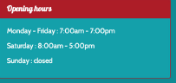
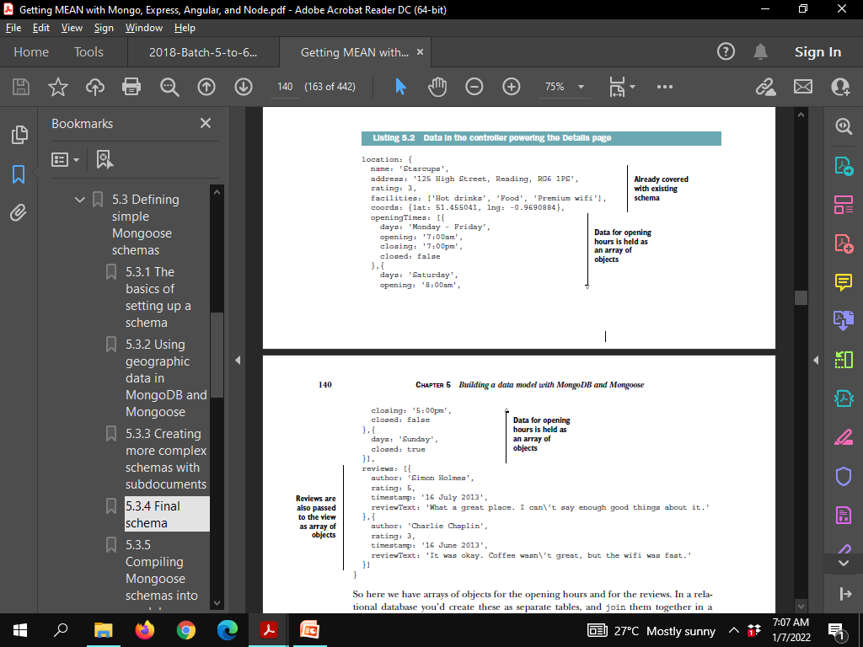
Creating more complex schemas with subdocuments

Slide 27
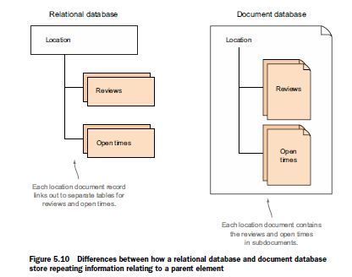
Differences between how a relational database and document database store repeating information relating to a parent element

Slide 28
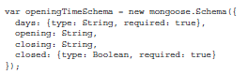
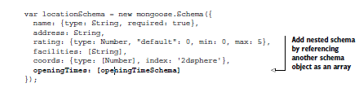
USING NESTED SCHEMAS IN MONGOOSE TO DEFINE SUBDOCUMENTS

Slide 29
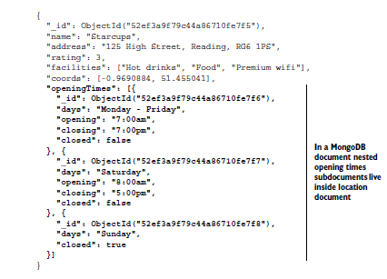
Location document

Slide 30
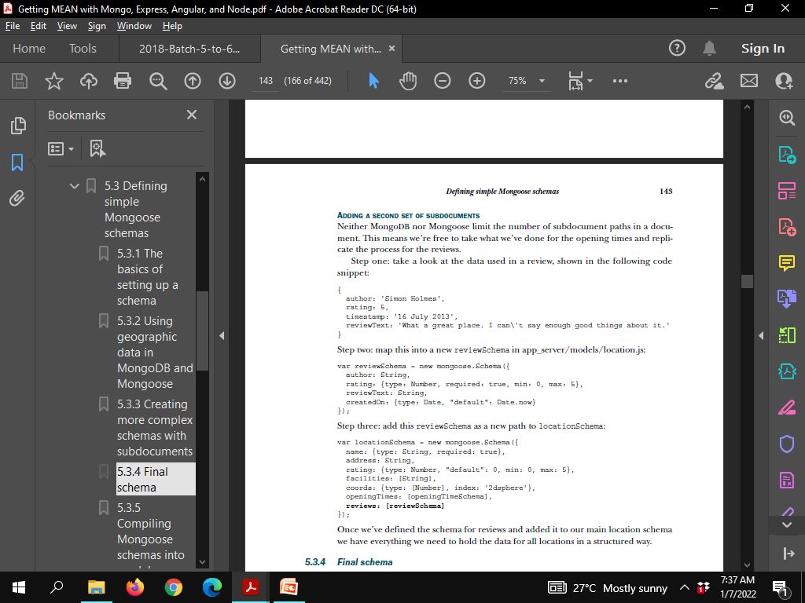
ADDING A SECOND SET OF SUBDOCUMENTS (Review document)

Slide 31
Review document

Slide 32
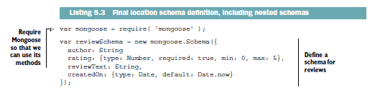
Final schema

Slide 33
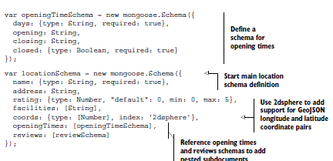
Final schema

Slide 34
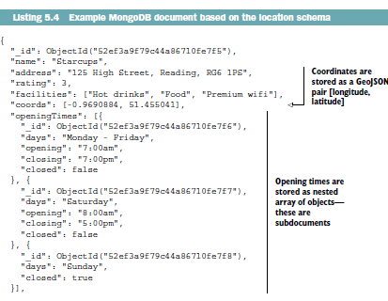
Location data

Slide 35
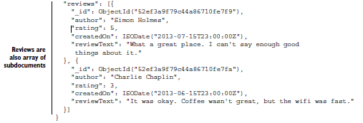
Location data(Contd)

Slide 36
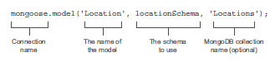
Compiling Mongoose schemas into models COMPILING A MODEL FROM A SCHEMA

Slide 37
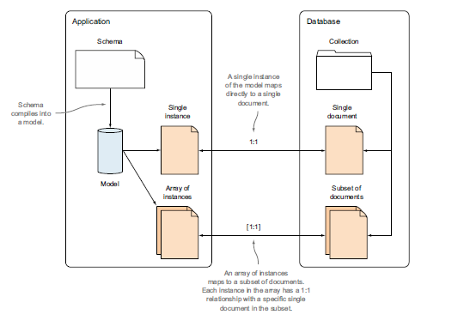
The application and database talk to each other through models. A single instance of a model has a one-to-one relationship with a single document in the database. It’s through this relationship that the creating, reading, updating, and deleting of data is managed.

